Slide 1
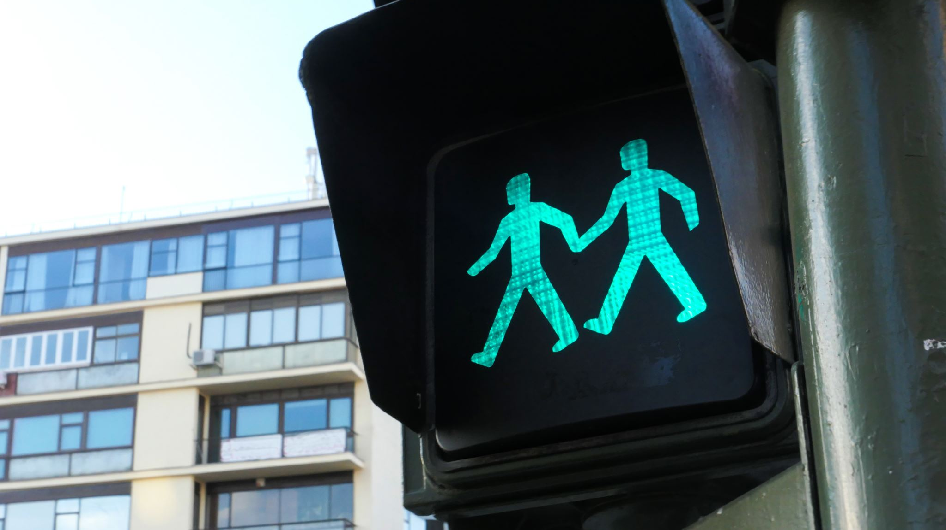
ASSIGNMENT -2 TRAFFIC SIGN CLASSIFICATION
SAI VARUN KOLLIPARA – C0828403
BHANU PRAKASH MAHADEVUNI – C0850515
DEEKSHA NAIKAP – C0835440
PRAMOD REDDY GURRALA – C0850493

Slide 2
Problem Statement
As the population increases rapidly, it is becoming difficult to monitor every moment that is happening in daily activities. But some human activities are to be observed as they will raise the risk. One of these activities is driving.
Since there is a more extensive scale of automobile usage, it is becoming difficult for humans. Such advanced technologies as automated cameras will be helpful.
In this case, we have built a CNN-based Image Classification Model that can vary 43 different types of traffic signs, for UI Tkinter front-end service from python is implemented.

Slide 3
Steps Involved
Loading the Packages
Loading the Dataset
Data Pre-processing
Check for errors while loading the images
Resizing all the photos into similar dimensions
Load the pictures into labels for further processing
Data Splitting
Model Building:
CNN Model Architecture
Data Visualization
Model Evaluation
UI Building:
UI Designing
UI Functions

Slide 4
About Dataset
This case study uses GTSRB - German Traffic Sign Recognition Benchmark image data. It is a multi-class, single-image classification challenge held at the International Joint Conference on Neural Networks (IJCNN) 2011.
43 Classes
more than 50K Images
real-time data
contains testing and training image data and image information in CSV files.

Slide 5
Data Pre Processing
In General, this phase prepares the data for machine learning or deep learning models. Pre-processing means all the invalid, incorrect, and outlier data will be removed from the dataset.
Since this is image-based data, we check all the directories for loading all the pictures and check for any errors. Next, we are changing the dimensions of all the images into a standard format to load the model.

Slide 6
Model Building
For our study, we use 80% for training and 20% for Testing.
The foremost step for every machine learning / deep learning is to build a model based on the data. The data type varies the algorithm, functions, and attributes to be implemented. For most deep learning projects, we can use Neural Networks like CNN, ANN, and RNN. Since this project, we have been using image data. It is advisable to use CNN(Convolution Neural Networks).
For the architecture we have built, we used:
conv2d layer
MaxPool2D
Dropout layer
Flatten layer
Dense layer
Epoch
Batch size

Slide 7
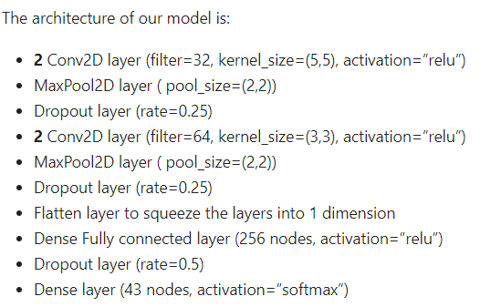
Model Building

Slide 8
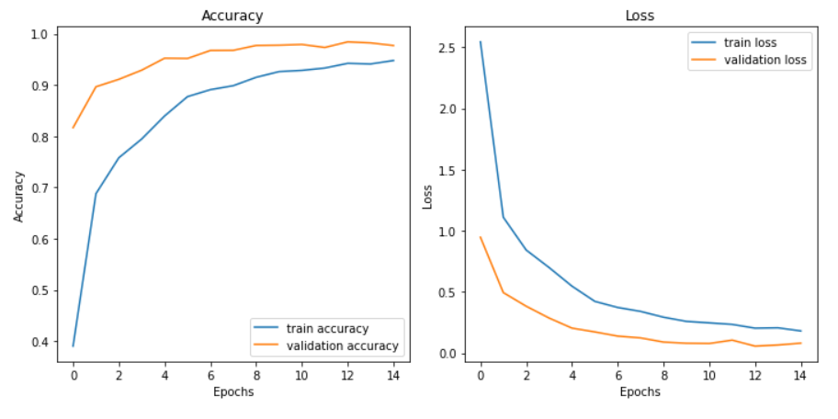
Data Visualization

Slide 9
UI Building
For our UI, we have selected using Tkinter Library. As per the requirement, we have added the required buttons and dimensions of the window. The steps involved are:
Loading the packages
Loading the CNN Model
Labeling the classes of the data
Set the Dimensions of the Window, Title, Font, and Button Placement.
Building the Functions for loading and classifying the Images.

Slide 10
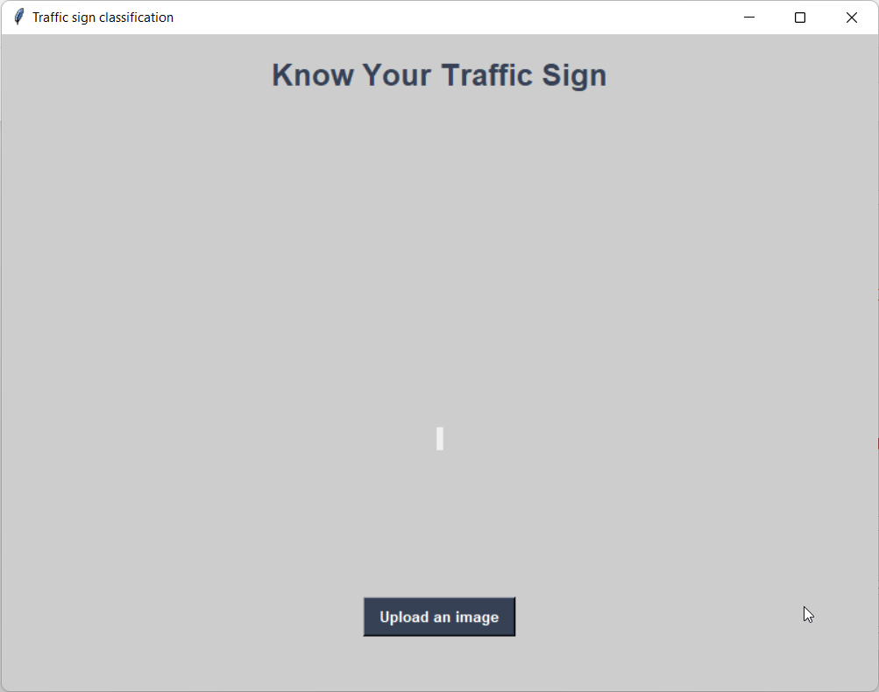
UI Building

Slide 11
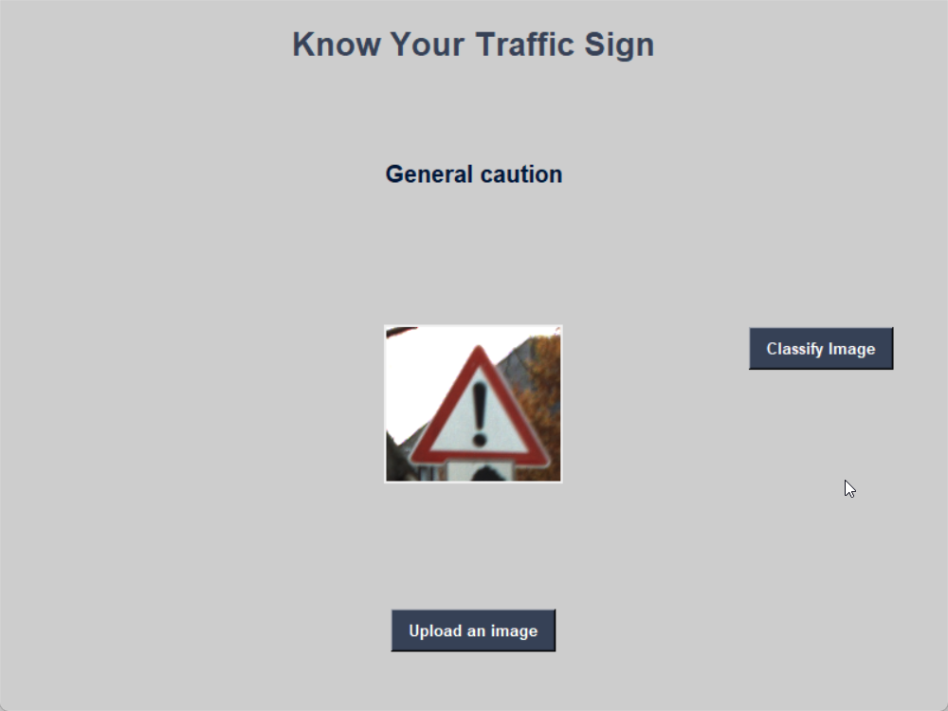
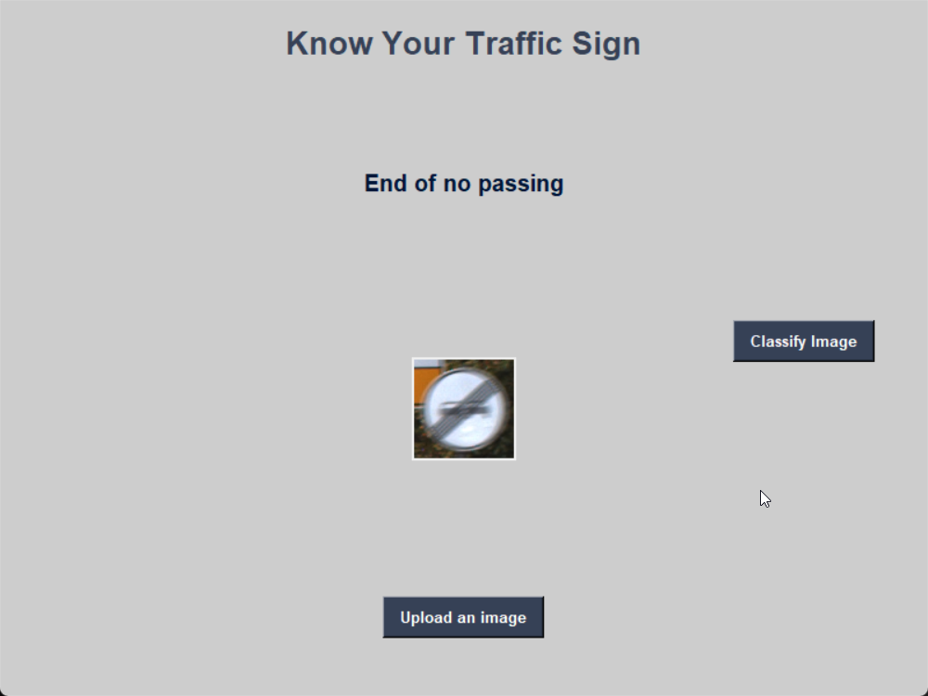
Results

Slide 12
Conclusion and Future Developments
From this project, we conclude that CNN is suitable for handling the image type data. We also identified how to build the architecture of a CNN model to increase productivity. Coming to UI, we learned how to integrate the front-end with the back-end model.
Some of the applications that can be built by using this as a base are:
Sign Detection in Self-Driving Cars
Automobiles that are not following the signs
Notifying the driver regarding the upcoming signs

Slide 13
References
https://www.quora.com/What-is-the-purpose-of-using-more-than-one-convolutional-layer-in-a-convolutional-neural-network
https://www.quora.com/What-is-max-pooling-in-convolutional-neural-networks
https://www.quora.com/What-does-a-dropout-in-neural-networks-mean
https://www.quora.com/What-is-the-meaning-of-flattening-step-in-a-convolutional-neural-network
https://www.quora.com/In-Keras-what-is-a-dense-and-a-dropout-layer
https://www.kaggle.com/datasets/meowmeowmeowmeowmeow/gtsrb-german-traffic-sign?datasetId=82373&sortBy=voteCount

Slide 14
Thank You

